Slide 1
Uganda Intergovernmental Fiscal Transfers Program (UGIFT)
ASSET VERIFICATION PROCESS TRAINING
AUGUST 2026

Slide 2
Local Government Governance Structures
Political Structure- HLG and LLGs
Technical Structure-HLG and LLGs
Central Government Representation-RDCs

Slide 3
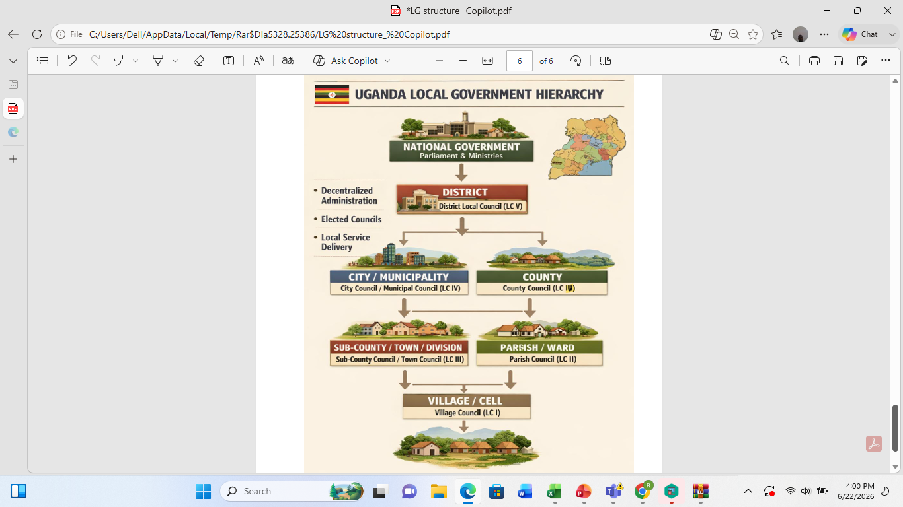
LG Structure

Slide 4
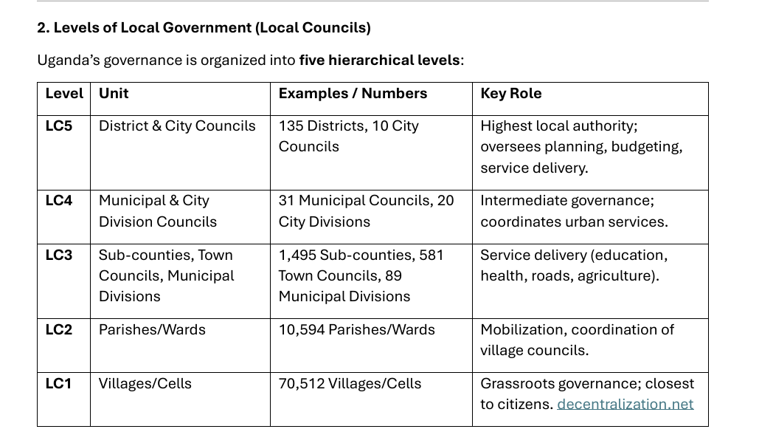

Slide 5
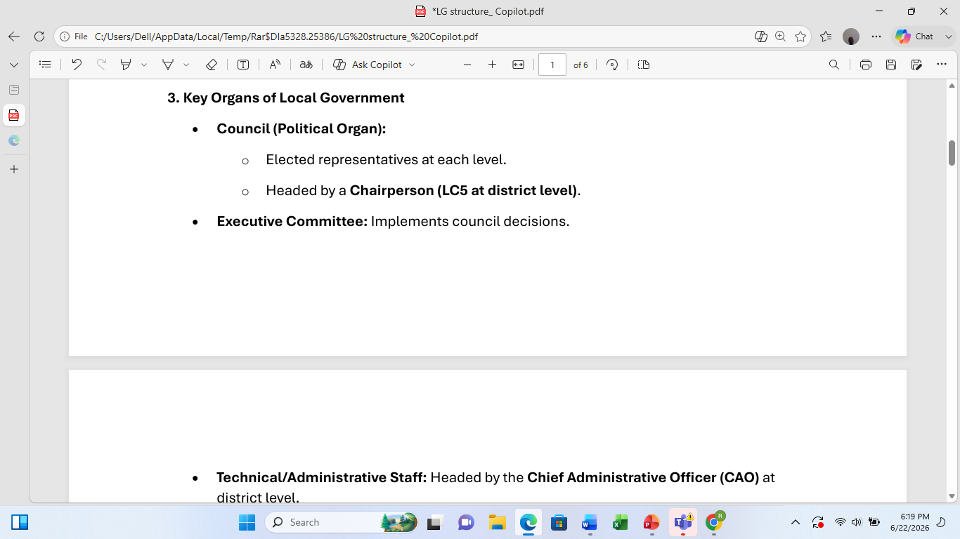

Slide 6
Thank You

